Slide 1
Smart Greenify Device
A project that makes indoor planting easier!

Slide 2
Interfacing Google Cloud with Raspberry pi
Presented by,
Anna Joy, C0769402
Individual meeting 3, Group 1.

Slide 3
Introduction
Smart Greenify is a device that helps indoor plants to survive without much effort from the owner.
Among different features, one of the interesting feature is cloud storage.
This feature paves new ways to access the required information and notifications from anywhere and everywhere.

Slide 4

What is Cloud Computing?

Slide 5
What is Cloud Computing?
Cloud is a model of computing where servers, networks, storage, development tools, and even applications (apps) are enabled through the internet.
Cloud computing is accounted as an easy way to store data and access it other than the conventional methods.
So in simple words Cloud is fast, it enables innovation, is scalable and it saves a lot of money.

Slide 6
Cloud IoT Core
A fully managed service to easily and securely connect, manage, and ingest data from globally dispersed devices.
IoT Core runs on Google’s serverless infrastructure, which scales automatically in response to real-time changes and adheres to stringent industry-standard security protocols that protect business data.

Slide 7
Cloud IoT Core
can easily reduce capital expenditures on your IoT projects and maintenance costs with a pay-as-you-go service.
This establish a two way communication with our devices.

Slide 8
On Google Cloud
Step 1: Enable the Cloud IoT Core and Cloud Pub/Sub APIs.
Following this link:
https://console.cloud.google.com/flows/enableapi?apiid=cloudiot.googleapis.com,pubsub&_ga=2.214956752.655476539.1626648635-1854975120.1626472934
On the Enable APIs, we can create a new project too

Slide 9
On Google Cloud
Step 2:
Go to the Google Cloud IoT Core page in Cloud Console.
Click Create registry.
Enter rasp-registry for the Registry ID of the raspberry pi
If you're in the US, select us-central1 for the Region. If you're outside the US, select your preferred region.
Select MQTT for the Protocol. (for low energy device)
In the Cloud Pub/Sub topics dropdown list, select Create a topic.
In the Create a topic dialog, enter iot-data in the Name field.
Click Create in the Create a topic dialog.
The Device state topic and Certificate value fields are optional, so leave them blank.
Click Create on the Cloud IoT Core

Slide 10
Before going to step 3, we need to:
**Create our credentials in this one we need to switch to the raspberry pi **
Open a terminal window and run the following multi-line command to create an RS256 key
openssl req -x509 -newkey rsa:2048 -keyout rsa_private.pem -nodes \ -out rsa_cert.pem -subj "/CN=unused"
Run cat rsa_ceft.pem to see the public key generated by RS256

Slide 11
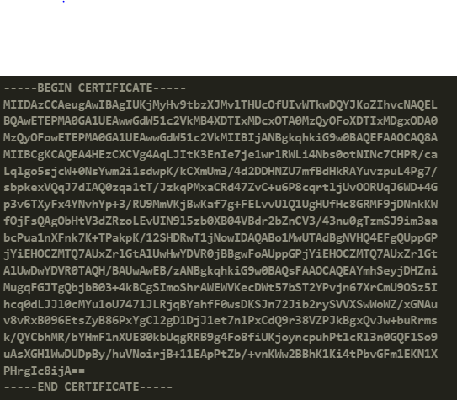

Slide 12
**Switch back to Google cloud UI*
STEP 3:
On the Registries page, select rasp-registry.
Select the Devices tab and click Create a device.
Enter raspi-device for the Device ID.
Select Allow for Device communication.
Add the public key information to the Authentication fields.
Copy the contents of rsa_cert.pem to the clipboard. Make sure to include the lines that say -----BEGIN CERTIFICATE----- and -----END CERTIFICATE-----.
Select RS256_X509 for the Public key format.
Paste the public key in the Public key value box.
Click Add to associate the RS256_X509 key with the device.
The Device metadata field is optional; leave it blank.
Create

Slide 13
Step 1
On Raspberry pi run the following two commands to get it updated
sudo apt-get update
sudo apt-get upgrade

Slide 14
Step 2
Installing nvm
From ~/home
clone this repo in the root of the user profile
cd ~/ from anywhere then git clone https://github.com/nvm-sh/nvm.git .nvm
cd ~/.nvm
check out the latest version with git checkout v0.38.0
activate nvm by sourcing it from your shell: . ./nvm.sh

Slide 15
Step 2
Now add these lines to the ~/.bashrc, ~/.profile, or ~/.zshrc file to have it automatically sourced upon login: (you may have to add to more than one of the above files) - using nano editor
For example:
pi@raspberrypi:~/.nvm $ sudo nano ~/.bashrc
pi@raspberrypi:~/.nvm $ sudo nano ~/.profile

Slide 16
Step 2
The lines need to be added:
export NVM_DIR="$HOME/.nvm" [ -s "$NVM_DIR/nvm.sh" ] && \. "$NVM_DIR/nvm.sh" # This loads nvm [ -s "$NVM_DIR/bash_completion" ] && \. "$NVM_DIR/bash_completion" # This loads nvm bash_completion
To install or update nvm, we should run the install script. To do that, we may either download and run the script manually or use the following cURL command:
curl -o- https://raw.githubusercontent.com/nvm-sh/nvm/v0.38.0/install.sh | bash

Slide 17
Step 3
Once NVM is installed, install Node.js and npm.
To install the latest version of Node.js, run the following:
nvm install stable
Optional: To check what version of Node.js that you're running, run the following:
pi@raspberrypi:~/.nvm $ node -v v16.5.0

Slide 18
Step3
npm is the Node Package Manager for Node.js and is normally installed alongside Node.js. You use npm to install Node.js packages from the npm repository. For example:
npm install --save express

Slide 19
Step 4
Get the Cloud IoT Core Node.js samples from GitHub. The Cloud IoT Core samples are in the iot directory.
git clone https://github.com/googleapis/nodejs-iot.git

Slide 20
Step 5
In your cloned repository, navigate to the iot/mqtt_example directory. You'll complete the rest of these steps in this directory.
cd nodejs-iot/samples/mqtt_example

Slide 21
Step 6
Copy the private key you created in the previous section (rsa_private.pem) to the current directory
cp ../../../rsa_private.pem .

Slide 22
Step 7
The last security piece is to grab the Google roots.pem file so your device knows it’s talking to Google. Again, on the Pi if possible, off the Pi and transfer it over if not, run:
wget https://pki.google.com/roots.pem

Slide 23
Switch to the host machine - laptop Side
Step 1 install Google cloud sdk for laptop (Window in this case):
https://cloud.google.com/sdk/docs/install#windows
Step 2 start the google cloud sdk from command line
gcloud app deploy
Step 3: Run the following command to create a subscription to the registry's Pub/Sub topic, substituting your project ID:
gcloud pubsub subscriptions create \ projects/PROJECT_ID/subscriptions/my-subscription \ --topic=projects/PROJECT_ID/topics/my-device-events

Slide 24
With PROJECT_ID of our project is: august-cascade-320302 and the my-device-events has to match with our already created pub “iot-data”
=>
gcloud pubsub subscriptions create projects/august-cascade-320302/subscriptions/my-subscription --topic=projects/august-cascade-320302/topics/iot-data

Slide 25
Back to Raspberry Pi
Run the following command to connect a virtual device to Cloud IoT Core using the MQTT bridge, substituting your project ID. Make sure serverCertFile is set to the location where you downloaded Google's root certificate
node cloudiot_mqtt_example_nodejs.js \ mqttDeviceDemo \ --projectId=PROJECT_ID \ --cloudRegion=REGION \ --registryId=my-registry \ --deviceId=my-device \ --privateKeyFile=rsa_private.pem \ --serverCertFile=roots.pem \ --numMessages=25 \ --algorithm=RS256

Slide 26
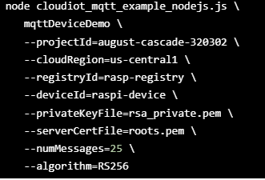
Editing the PROJECT_ID, REGION, my-registry, my-device match with our project setting, which will be:
This will send the message from the raspberry pi to the cloud

Slide 27
Result
Google Cloud IoT Core MQTT example. connect Publishing message: rasp-registry/raspi-device-payload-1 Config message received: Publishing message: rasp-registry/raspi-device-payload-2 Publishing message: rasp-registry/raspi-device-payload-3 Publishing message: rasp-registry/raspi-device-payload-4 Publishing message: rasp-registry/raspi-device-payload-5 Publishing message: rasp-registry/raspi-device-payload-6 Publishing message: rasp-registry/raspi-device-payload-7 Publishing message: rasp-registry/raspi-device-payload-8 Publishing message: rasp-registry/raspi-device-payload-9 Publishing message: rasp-registry/raspi-device-payload-10 Publishing message: rasp-registry/raspi-device-payload-11 Publishing message: rasp-registry/raspi-device-payload-12 Publishing message: rasp-registry/raspi-device-payload-13 Publishing message: rasp-registry/raspi-device-payload-14 Publishing message: rasp-registry/raspi-device-payload-15 Publishing message: rasp-registry/raspi-device-payload-16 Publishing message: rasp-registry/raspi-device-payload-17 Publishing message: rasp-registry/raspi-device-payload-18 Publishing message: rasp-registry/raspi-device-payload-19 Publishing message: rasp-registry/raspi-device-payload-20 Publishing message: rasp-registry/raspi-device-payload-21 Publishing message: rasp-registry/raspi-device-payload-22 Publishing message: rasp-registry/raspi-device-payload-23 Publishing message: rasp-registry/raspi-device-payload-24 Publishing message: rasp-registry/raspi-device-payload-25 Closing connection to MQTT. Goodbye! close

Slide 28
To check the message, we can do by two ways:
From CLI (Command line interface) or
Directly on the google cloud web UI

Slide 29
From CLI
From CLI On the Google Shell (Command line on host machine) type this:
gcloud pubsub subscriptions pull --auto-ack \ projects/PROJECT_ID/subscriptions/my-subscription
where PROJECT_ID is our project id

Slide 30
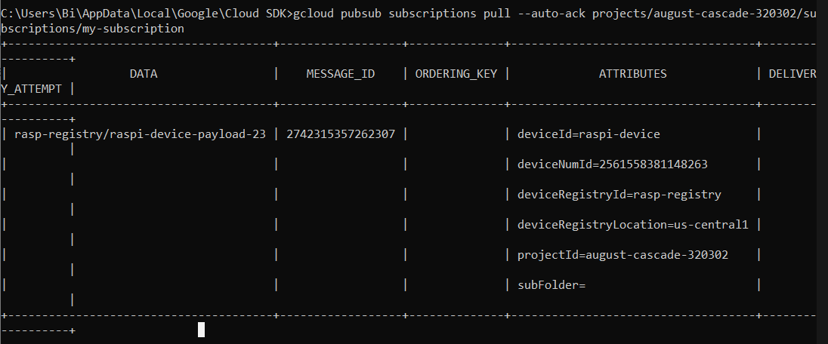
Result

Slide 31
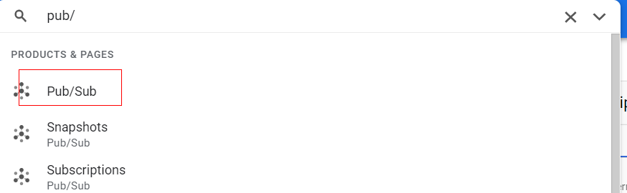
From Google Cloud
Step 1 Search for the pub/sub from the search tool

Slide 32
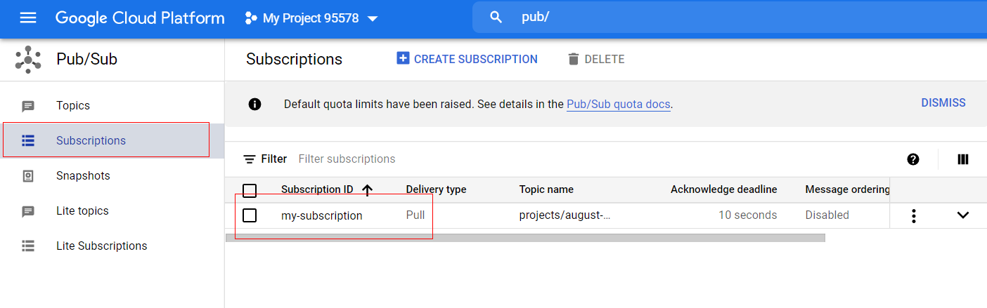
Step 2 Go to my-subscription on the Subscription menu

Slide 33
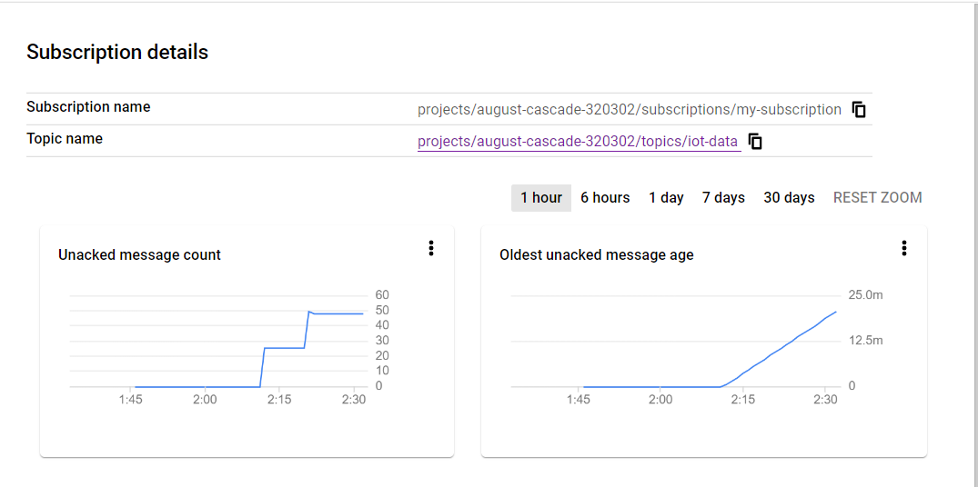
We will see the graph of the messages that have been sent:

Slide 34
Step 3 And to view the message, go to the” VIEW MESSAGE” option
Step 4 Click Pull

Slide 35
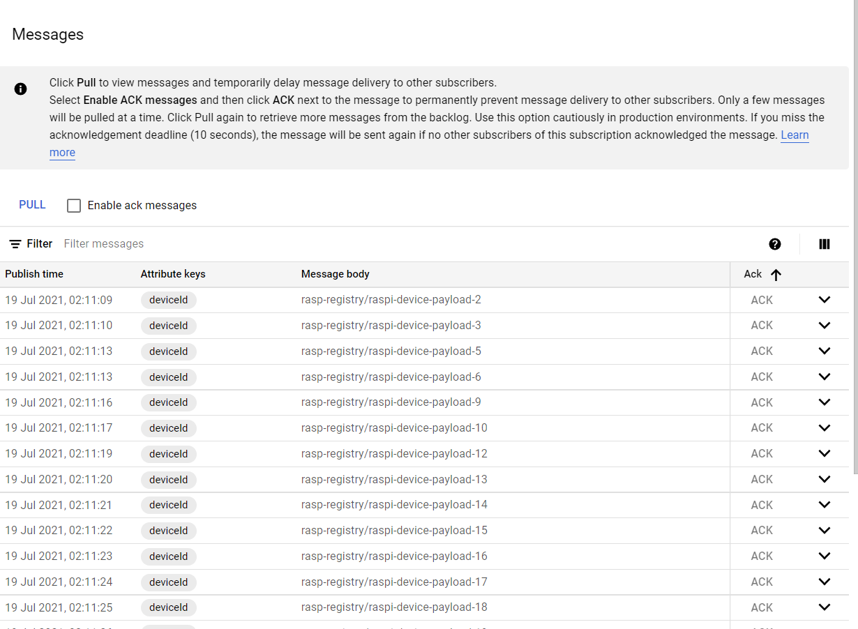
Result

Slide 36
Thank you

Slide 37
References
Medium. 2021. Cloud IoT step-by-step: Connecting Raspberry PI + Python. [online] Available at: <https://medium.com/google-cloud/cloud-iot-step-by-step-connecting-raspberry-pi-python-2f27a2893ab5> [Accessed 19 July 2021].
Accenture.com. 2021. What is Cloud Computing & Why is it Important? | Accenture. [online] Available at: <https://www.accenture.com/ca-en/insights/cloud-computing-index?c=acn_glb_brandexpressiongoogle_12261974&n=psgs_0621&gclid=CjwKCAjwos-HBhB3EiwAe4xM904FqOZ1-m9tG-5x4rd3qn5J2HEmFifahotfX8ihYUSsC6fmD94vJxoCaTUQAvD_BwE&gclsrc=aw.ds> [Accessed 19 July 2021].

Slide 38
References
3. Google Cloud. 2021. Cloud IoT Core | Google Cloud. [online] Available at: https://cloud.google.com/iot-core [Accessed 19 July 2021].
4. Pi, R. and NodeJS, C., 2021. Connect Raspberry Pi to Google Cloud IoT (GCP IoT) using NodeJS. [online] SwA. Available at: <https://www.survivingwithandroid.com/connect-raspberry-pi-to-google-cloud-iot-nodejs/> [Accessed 19 July 2021].

